Slide 1
Cloud Computing
SE489: DevOps Engineering

Slide 2
Outline
Cloud Computing
Virtualization – the underlined technology

Slide 3
Cloud Computing

Slide 4
What is Cloud Computing?
Computing as a utility
Utility services e.g. water, electricity, gas, etc.
Consumers pay based on their usage
According to NIST Cloud computing is a model for enabling ubiquitous, convenient, on-demand network access to a shared pool of configurable computing resources (e.g., networks, servers, storage, applications, and services) that can be rapidly provisioned and released with minimal management effort or service provider interaction.

Slide 5
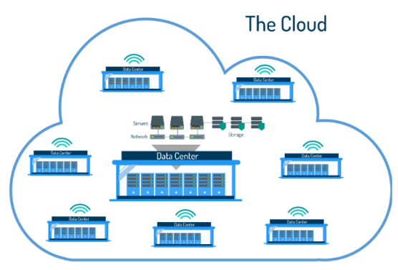
What is Cloud Computing?
Cloud computing is the delivery of shared computing resources (software and/or data) on-demand through the internet

Slide 6
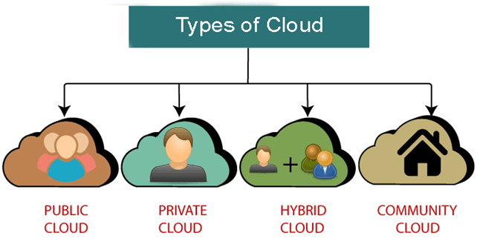
Cloud deployment model
Cloud deployment includes an emphasize on where the hardware or software is running and who is controlling it.
Private Cloud
Community Cloud
Public Cloud
Hybrid Cloud
What do you mean by deployment model ?
Who is the targeted user?
Each cloud model is a representative of a specified environment and is distinguished by
Size
Access
Storage and
Ownership.

Slide 7
Cloud deployment models comparison
Description | Public Cloud | Private Cloud | Hybrid Cloud
Cloud environment | Multi-Tenancy-Shared environment. | Single tenancy-only for single use of an organization. | Both single tenancy and multi –tenancy.
Data center location | Anywhere | Inside the organization’s network. | Both
Resource sharing (Server hardware, network and storage) | shared by multiple users in the cloud. | No sharing of resources. | Very secure; integration options add an additional layer of security.

Slide 8
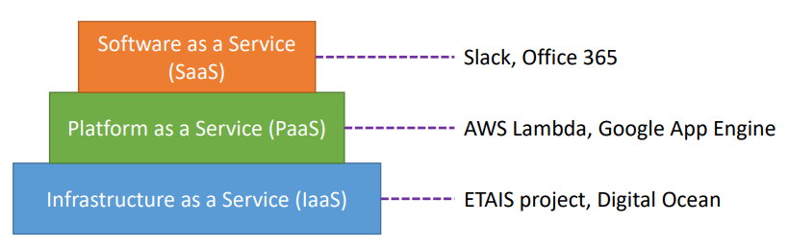
Types of Cloud Computing service models
Cloud computing is categorized into different service models.
Software as a Service (SaaS)
Platform as a Service (PaaS)
Infrastructure as a Service (IaaS)

Slide 9
Virtualization – the underlined technology

Slide 10


Virtualization Platform
Separation of Virtual Machine from Physical Infrastructure
A VM is an isolated runtime environment (guest OS and applications)
Multiple virtual systems (VMs) to run on a single physical system
Applications Applications
Applications
VM
Guest OS
VM
Guest OS
VM
Guest OS
Virtualization Platform (Xen, KVM, VMware…)
Physical Box (Processor, RAM, Memory, Network, Chipset, Storage ...)
Benefits of Virtualization Platforms
Natural way to deal with the heterogeneity of the infrastructure
Allow partitioning and isolating of physical resources
Execution of legacy applications

Slide 11
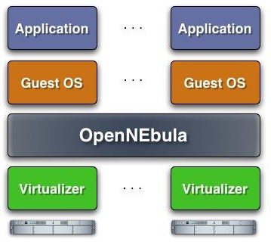
Distributed Management of VMs
Extending the Benefits of Virtualization to a Physical Cluster
VM Managers creates a distributed virtualization layer
Extend the benefits of VM Monitors from one to multiple resources
Decouple the VM (service) from the physical location
Benefits of VM Managers
Centralized management
Balance of workload
Server consolidation
Dynamic resizing of the infrastructure
Dynamic cluster partitioning
Support for heterogeneous workloads
On-demand provision of VMs

Slide 12





Past, Present & Future of Virtualization
Legacy computing
Virtualization
But VMs are
App 1 | App 2 App n VMs
Guest | Guest |  | Guest
OS | OS |  | OS
Hypervisor
Host Operating System
Physical Infrastructure
Cold start
Need more storage
- Less number of virtual machines per PI
….
App 1
App 2
App n
….
HOST
HOST
HOST
PI
PI
PI
PI: Physical Infrastructure

Slide 13

Past, Present & Future of Virtualization
Legacy computing
Virtualization
But VMs are
App 1 | App 2 App n VMs
Guest | Guest |  | Guest
OS | OS |  | OS
Hypervisor
Host Operating System
Physical Infrastructure
Cold start
Need more storage
- Less number of virtual machines per PI
….
App 1
App 2
App n
….
HOST
HOST
HOST
PI
PI
PI
Containers
The Future of Virtualization
PI: Physical Infrastructure

Slide 14


Past, Present & Future of Virtualization
Legacy computing
Virtualization
Containerization
Lightweight
Require less memory space
Fast lunch time
better resource utilization
- 1000s of containers can be loaded onto a Host
App 1 | App 2 App n VMs
Guest | Guest |  | Guest
OS | OS |  | OS
Hypervisor
Host Operating System
Physical Infrastructure
App 1
.
App n
….
App 2
Containers
App 1
App 2
App n
….
Bins/
Libs
Lib…s Bins/
Bins/ Libs
Docker Engine
HOST
HOST
HOST
Host Operating System
PI
PI
PI
Physical
Infrastructure
Containerized apps share Host OS’s kernel to execute work
Workload in Containers use Host OS kernel

Slide 15
Past, Present & Future of Virtualization
Legacy computing
Virtualization
Containerization
Lightweight
Require less memory space
Fast lunch time
better resource utilization
- 1000s of containers can be loaded onto a Host
App 1 | App 2 App n VMs
Guest | Guest |  | Guest
OS | OS |  | OS
Hypervisor
Host Operating System
Physical Infrastructure
….
App 1
App 2
….
Containers
App 1
App 2
App n
….
Bins/
Libs
Lib…s Bins/
Bins/ Libs
Docker Engine
HOST
HOST
HOST
Host Operating System
PI
PI
PI
Physical
Infrastructure
Containerized apps share Host OS’s kernel to execute work
Workload in Containers use Host OS kernel
Will be discuss in another Lecture

